Slide 1
GROUP THEORY
INTRODUCTION

Slide 2
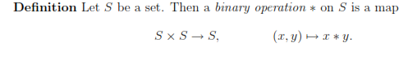
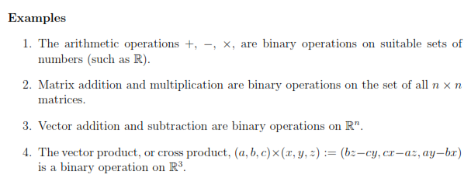
BINARY OPERATION

Slide 3
DEFINITION
A set (G,*) is said to be a group if it satisfies the following properties:
(a)Closure:
(b) Associative:
(c)Existence of Identity:
(d)Existence of Inverse:
Note: G is abelian
Note: If (a) &(b) satisfied G is a semi-group
If (a),(b) & (c) satisfied G is a Monoid

Slide 8
Examples
(N,+) is a Semi-group as it satisfies closure and associative property(N- Natural numbers)
(W,+) is a Monoid as it satisfies closure,associative with the additive identity ‘0’. (Whole Numbers)
(Z,+) is a Group (Z- Integers)
0 is the additive Identity
Inverse of a is –a for all a in Z
Note: (Z,+) is abelian
4. Set of all 2 x 2 matrices over integers under matrix addition is an example of an abelian group

Slide 12
Examples continued
1. Z₅ = {0,1,2,3,4}. (Z₅ ,+₅ ) is a group where +₅ denotes addition modulo 5.
+₅ | 0 | 1 | 2 | 3 | 4
0 | 0 | 1 | 2 | 3 | 4
1 | 1 | 2 | 3 | 4 | 5
2 | 2 | 3 | 4 | 0 | 1
3 | 3 | 4 | 0 | 1 | 2
4 | 4 | 0 | 1 | 2 | 3

Slide 17
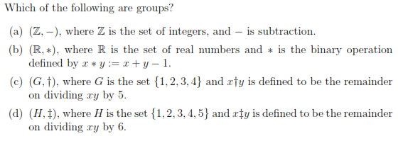

Slide 18
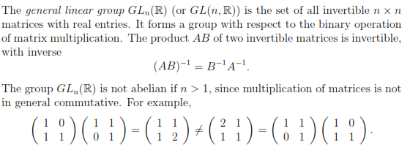
MORE EXAMPLES

Slide 27
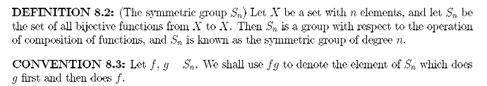

Slide 28
TRY
1. Show that G={1,-1,i,-i} is a group under usual multiplication.
2. If * is defined on R such that a*b=a+b-ab, for a,b R, show that (R,*) is an abelian group.
3. If * is defined on Q⁺ such that a*b=ab/3, for a,b Q⁺, show that {Q⁺,*} is an abelian group.
4. Show that the following sets of 2X2 matrices form a group under matrix multiplication

Slide 32
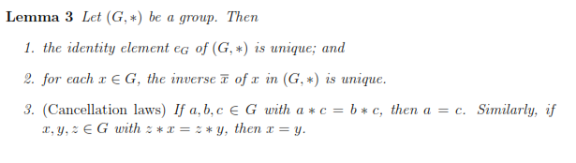

Slide 33
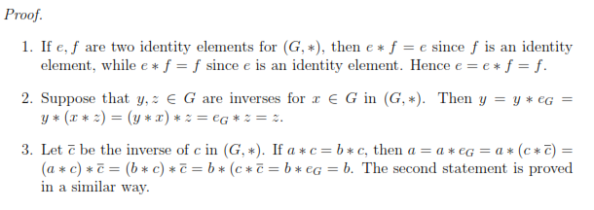

Slide 34
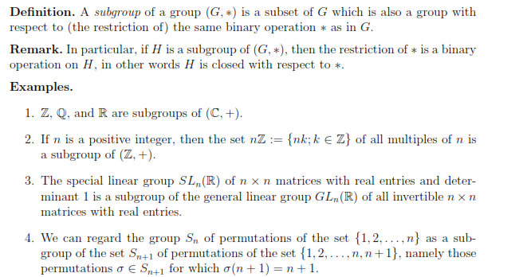

Slide 42
Example 1.4.1 In the group ({1,−1, i,−i}, ・), the subset {1,−1} forms a subgroup because this subset is closed under multiplication

Slide 44
Theorem 1: A subset H of a group G is a subgroup if and only if
(i) (a∈H,b∈H)⇒a*b∈H and (ii) a∈H⇒a’∈H
Proof:
Suppose H is a subgroup of G then H must be closed with respect to composition * in G, i.e. a∈H,b∈H⇒a*b∈H. Let a∈H and a’ be the inverse of a in G. Then the inverse of a in H is also a’. As H itself is a group, each element of H will possess inverse in it, i.e. a∈H⇒a’∈H. Thus the condition is necessary. Now let us examine the sufficiency of the condition.

Slide 45
(i) Closure Axiom. a∈H,b∈H⇒a*b∈H. Hence closure axiom is satisfied with respect to the operation *. (ii) Associative Axiom. Since the elements of H are also the elements of G, the composition is associative in H also. (iii) Existence of Identity. The identity of the subgroup is the same as the identity of the group because, a∈H,a’∈H⇒a*a’∈H⇒e∈H. The identity e is an element of H. (iv) Existence of Inverse. Since a∈H⇒a’∈H, ∀a∈H. Therefore each element of H possesses inverse. The H itself is a group for the composition * in G. Hence H is a subgroup.

Slide 46
Theorem 2: A necessary and sufficient condition for a non-empty subset H of a group G to be a subgroup is that a∈H,b∈H⇒a*b’∈H where b’ is the inverse of b in G.
Proof: Necessary condition
Suppose H is a subgroup of G and let a∈H,b∈H. Now each element of H must possess inverse because H itself is a group.
b∈H⇒b’∈H
Also H is closed under the composition * in G. Therefore
a∈H,b’∈H⇒a*b’∈H

Slide 47
Sufficient condition
It is given that a∈H,b’∈H⇒a*b’∈H then we have to prove that that H is a subgroup
(i) Closure Property. Let a,b∈H then b∈H⇒b’∈H (as shown above).
Therefore by the given condition
a∈H,b’∈H⇒a*(b’)’∈H⇒a*b∈H
Thus H is closed with respect to the composition * in G.
(ii) Associative Property. Since the elements of H are also the elements of G, the composition is associative in H.

Slide 48
(iii) Existence of Identity. Since
a∈H,a’∈H⇒a*a’∈H⇒e∈H
(iv) Existence of Inverse. Let a∈H then
e∈H,a∈H⇒e*a’∈H⇒a’∈H
Then each element of H possesses inverse. Hence H itself is a group for the composition ∘ in group G.

Slide 49
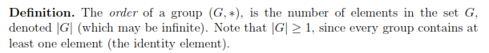
Defn: The order of an element a in G is the least positive integer m such that a^{m}=e, e is the identity of G.

